Slide 1
Credit Transfer: Cornerstone of the University System of Ohio

Slide 2
Driving Ohio’s Economy
Strategic Plan for Higher Education
Higher
Education
Driving
Ohio’s
Economy
Strategic Plan for Higher Education View and download online at: www.uso.edu

Slide 3
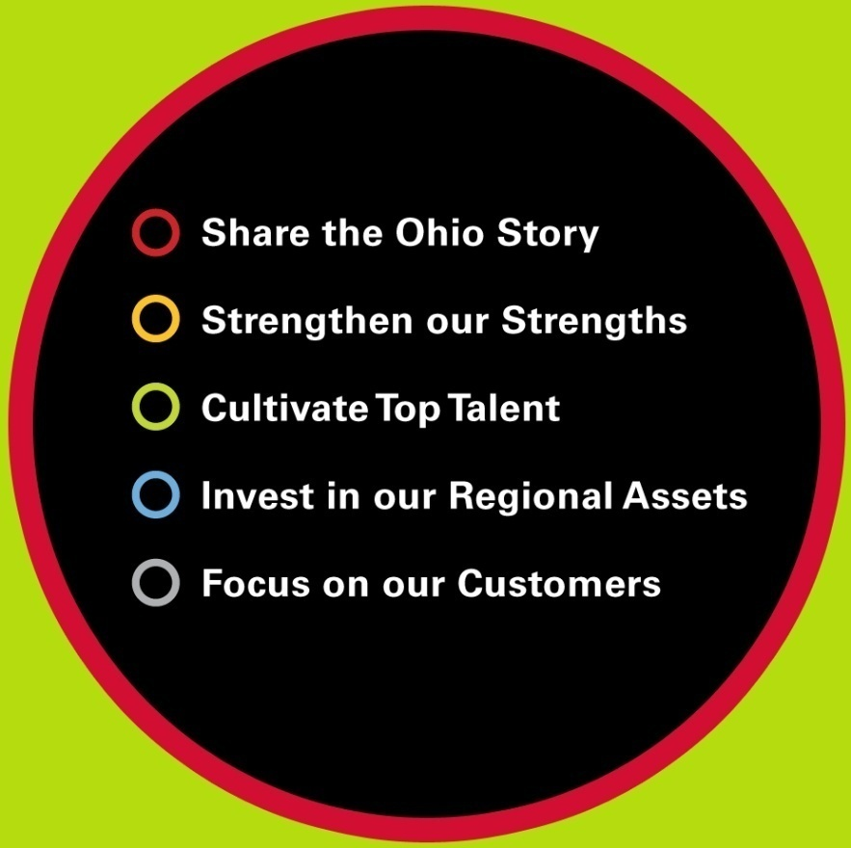
Driving Ohio’s Economy
Strategic Plan for Higher Education
University System of Ohio is aligned with Ohio Department of Development

Slide 4
Goal #1
Raise the Educational Attainment of Ohio
Graduating more students
Baseline
FY 2006
Current Level
FY 2008
Target
2017
Total Degrees Awarded | 72,657 | 74,127 | 100,000
Associate | 18,156 | 18,930 | 28,000
Bachelor’s | 37,816 | 38,233 | 52,000
Graduate and Professional | 16,685 | 16,964 | 20,000

Slide 5
Goal #2
Raise the Educational Attainment of Ohio
Keeping graduates in Ohio
Baseline
FY 2006
Current Level
FY 2008
Target
2017
Percentage of graduates living in Ohio 3 years after graduation | 66.26% | -- | 70.00%
Associate | 81.84% | -- | 85.00%
Bachelor’s | 62.71% | -- | 66.67%
Graduate and Professional | 56.44% | -- | 60.00%

Slide 6
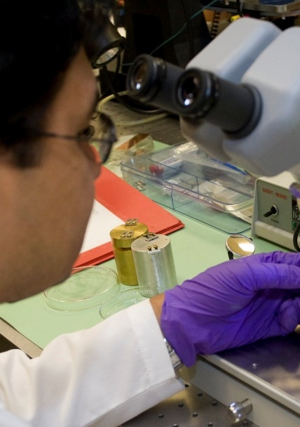
Goal #3
Raise the Educational Attainment of Ohio
Attracting more talent to Ohio
Baseline
FY 2006
Current Level
FY 2008
Target
2017
Number of degree holders entering the state minus number leaving each year (age 22-64) | -9,120 | -- | 10,000
Associate | 400 | -- | 2,000
Bachelor’s | - 5,826 | -- | 5,000
Graduate and Professional | - 2,894 | -- | 3,000

Slide 7
The University System of Ohio
14 Public Universities
24 Branch Campuses
23 Community Colleges
More than 200 Adult workforce Education Centers and Training Programs across the state

Slide 8
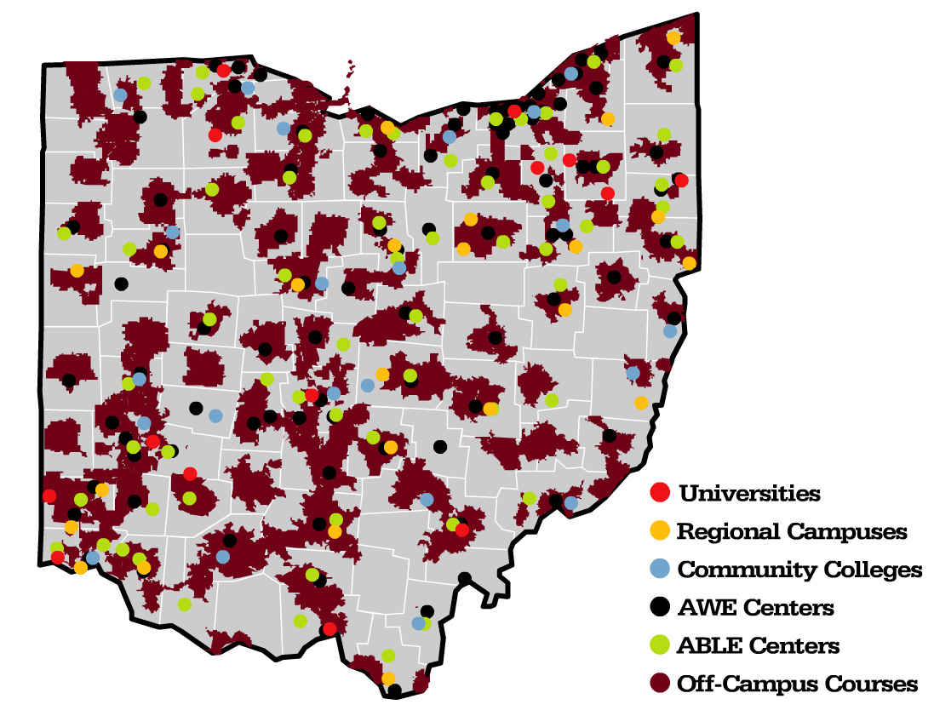
Size and Scope
University System of Ohio

Slide 9
Size and Scope
University System of Ohio
University System of Ohio
Sector and Institution | Fall 2007 Enrollment | FY 2008 Degrees Awarded
University Main Campuses | 257,867 | 57,034
University Regional Campuses | 48,700 | 2,588
Community Colleges | 177,101 | 14,505
University System of Ohio TOTAL Colleges + Universities | 483,668 | 74,127
Adult Workforce Education (AWE) | 114,194
Adult Basic and Literacy Education (ABLE) | 47,462
University System of Ohio TOTAL Colleges + Universities + AWE/ABLE | 645,324

Slide 10
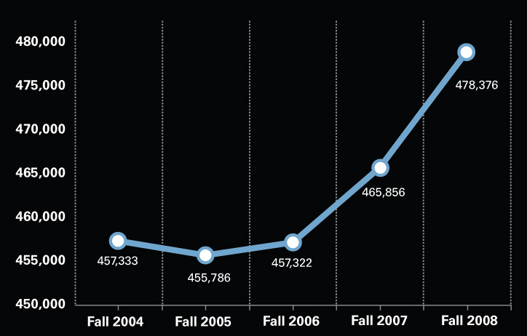
Size and Scope
University System of Ohio
Five Year Trend in Preliminary Headcount Enrollments
From Fall 2004 to Fall 2008

Slide 11
Size and Scope
University System of Ohio
2007-2008 Degrees Offered
8,054 degrees
(associate, bachelor’s, master’s, doctorate, and professional)
322 online degrees
3,364 online courses

Slide 12
Keys to Success of the System
University System of Ohio
Quality
Affordability
Flexibility

Slide 13
The Vision for Ohio’s Credit Transfer Initiatives
Seamless Student Mobility so each student can reach his/her highest level of educational attainment through statewide guarantees
A Student Web-Services Portal where a student has access to higher education information and services to help him/her reach their educational goals.

Slide 14
Background Information
Statewide transfer and articulation initiatives are the result of a concerted effort by dedicated legislative champions and higher education professionals at the state and institutional levels
Started back in 1990 with the Ohio Transfer Module
The Transfer Assurance Guides were effective in fall of 2005
Career Technical Assurance Guides followed

Slide 15
Transfer Assurance Guides
Define pathways to a Baccalaureate Degree
36 TAGs and more under development
TAG courses are guaranteed to transfer and apply toward the major. The courses are equivalent and carry a statewide guarantee.

Slide 16
Semester Hour Example
TRANSFER TO BACCALAUREATE DEGREE AND MAJOR
ASSOCIATE DEGREE
Pre-major & Major Courses –Additional hours
TAG
OHIO TRANSFER MODULE
(36-40 semester hours / 54-60 quarter hours)
Elective Courses – 16 semester hours
Courses in transfer module for major pathway
Required Courses – 24 semester hours
OTM
3 hrs. English
3 hrs. Math
6 hrs. Natural / Physical Sciences
6 hrs. Arts & Humanities
6 hrs. Social Sciences
Notes:
16
The Transfer Assurance Guide (noted here with the red dotted line), includes the Ohio Transfer Module – both required and elective courses, and then moves beyond those courses into additional hours in pre-major and major courses. In its totality, the TAG becomes a guaranteed pathway for students and is a very powerful advising tool for faculty and other advisors.
It is worthwhile to note that the Faculty Subcommittee and Transfer Module Review panel have been working to revise the criteria and guidelines by which coursework is accepted as being part of an college/university OTM. This is done to reflect the changes in general education over the past 10 years.
We’ve drafted (so far) approximately 38 different TAGs in 8 disciplinary areas.

Slide 17
Career Transfer Assurance Guides
Define educational pathways giving statewide guaranteed college credit for career-technical educational experiences that are equivalent to college courses based on third party industry standards
Presently have 17 CTAGs .
Ranging from IT-Networking and Information Support and Services to Emergency Medical Technician

Slide 18
Five Step Process
Define Learning Outcomes
Agree on Learning Outcomes
Match Course/Program against Learning Outcomes
Submit Course/Program for Faculty Review
Review Course/Program against Learning Outcomes

Slide 19
Electronic Tools
Articulation and Transfer Clearinghouse
Transcripts are sent electronically through this system
Course Equivalence Management System
All course/program reviews are done electronically
Reporting Systems
A searchable web-based resource that shows the statewide guarantees.

Slide 20
Ohio’s Credit Transfer Initiatives
Student-Focused and Faculty-Driven
Concerted effort by dedicated legislative champions and higher education professionals at the state and institutional levels.
GOAL: Students Reach Their Highest Level of Education Attainment

Slide 21
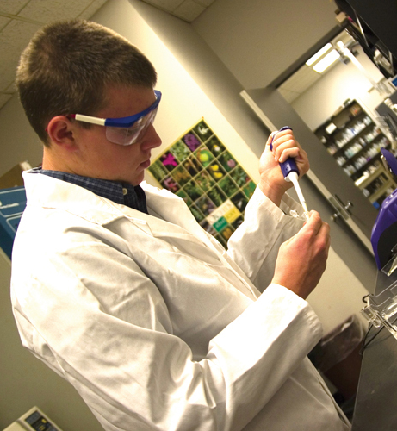
We will not back away from our strategic plan.
We will not retreat.
We will meet
our goals.
We will innovate.

Slide 22
Contact Information
Paula K. Compton, Ph.D.
Associate Vice Chancellor, Articulation and Transfer
pcompton@regents.state.oh.us
614.466.3334

Slide 23
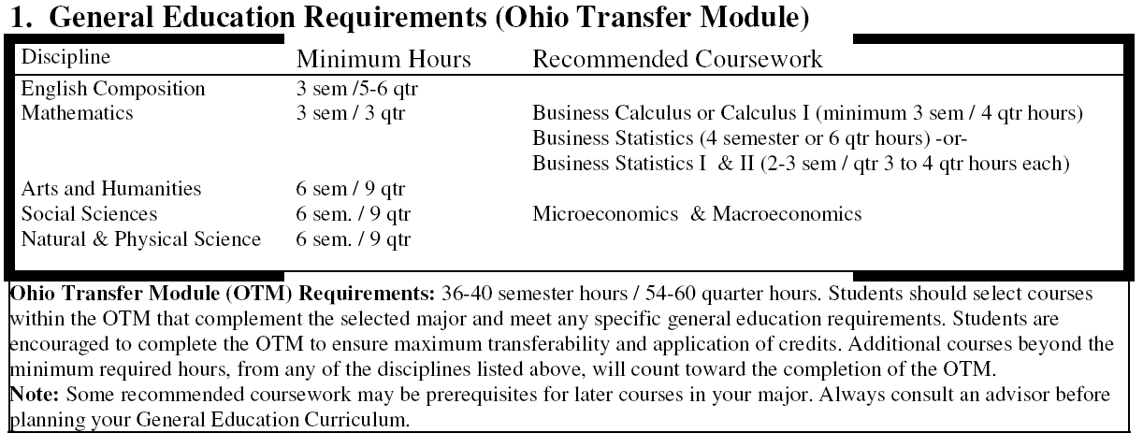
Anatomy of a TAG
Transfer Module with Recommendations

Slide 24
Anatomy of a TAG
Advising Notes

Slide 25
Anatomy of a TAG
Foreign Language (if applicable)

Slide 26
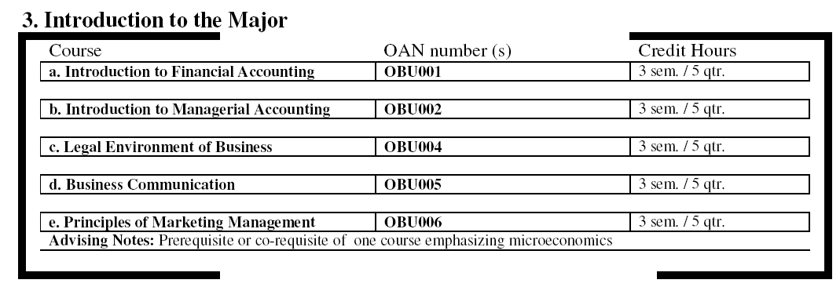
Anatomy of a TAG
Pre-major and Beginning Major Courses

Slide 27
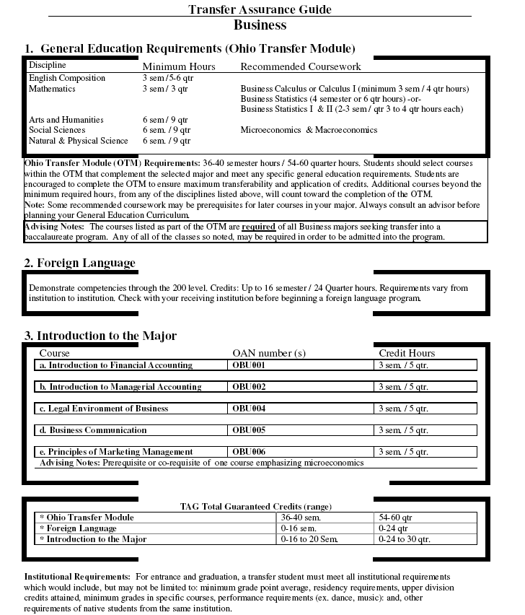

Slide 28
CONTACT INFORMATION
DR. PAULA K. COMPTON
ASSOCIATE VICE CHANCELLOR
ARTICULATION AND TRANSFER
THE OHIO BOARD OF REGENTS
pcompton@regents.state.oh.us

